Slide 1







MLOPS
Harmonizing People, Process, and Technology

Slide 2
THE DEVELOPMENT JOURNEY

Slide 3
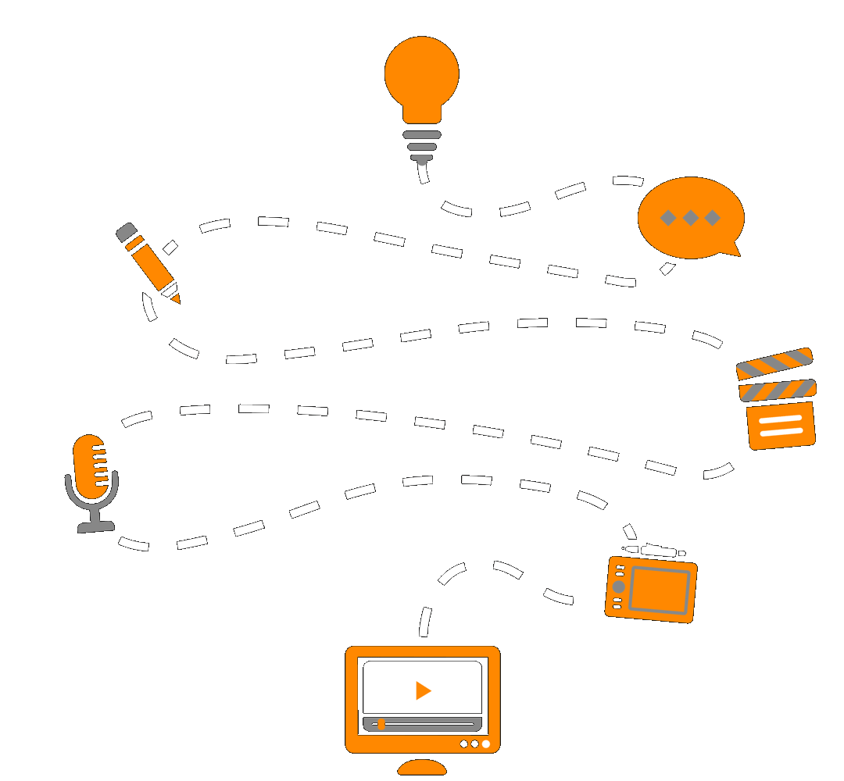
STEPS IN DEVELOPEMENT
Data Collection and Preparation :-
Model Training and Evaluation :-
Model Deployment and Monitoring :-

Slide 4
CHALLENGES IN AI DEPLOYMENT

Slide 5
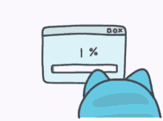
CHALLENGES FACED DURING DEPLOYMENT
Managing and versioning data
Maintaining reproducibility of ML experiments
Ensuring consistent performance in production
Handling model updates and monitoring

Slide 6

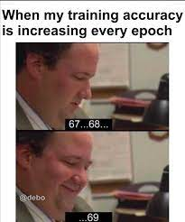


Slide 7
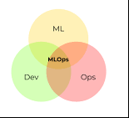
WHAT IS MLOPS ?
MLOps stands for Machine Learning Operations. MLOps is a core function of Machine Learning engineering, focused on streamlining the process of taking machine learning models to production, and then maintaining and monitoring them. MLOps is a collaborative function, often comprising data scientists, devops engineers, and IT.

Slide 8
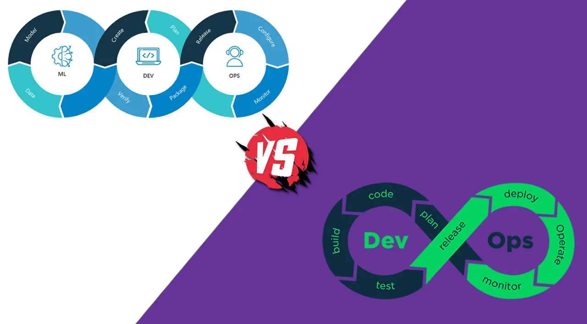
MLOPS VS DEVOPS
MLOps is a set of engineering practices specific to machine learning projects that borrow from the more widely-adopted DevOps principles in software engineering.
While DevOps brings a rapid, continuously iterative approach to shipping applications, MLOps borrows the same principles to take machine learning models to production.

Slide 9
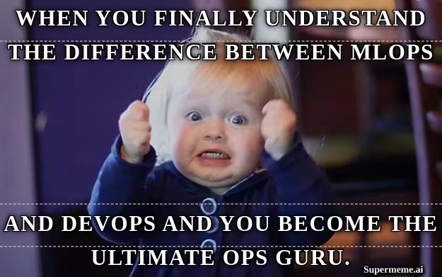
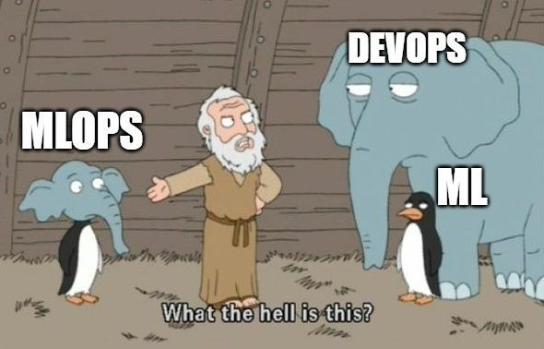

Slide 10
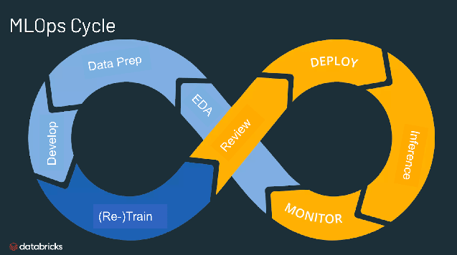

Slide 11
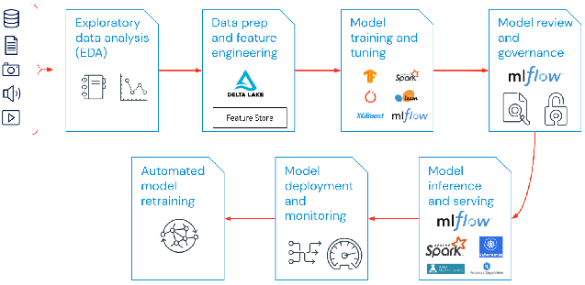
COMPONENTS OF MLOPS
People :-
Process :-
Technology :-

Slide 12




TOOLS USED IN THIS SESSION
Sci-kit Learn
Mlflow
Vscode
Vmware Workstation

Slide 13
SHALL WE SEE A DEMO OF MLOPS ?

Slide 14


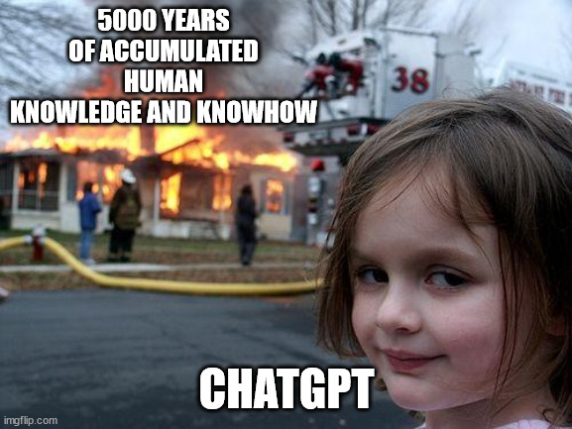

Slide 15
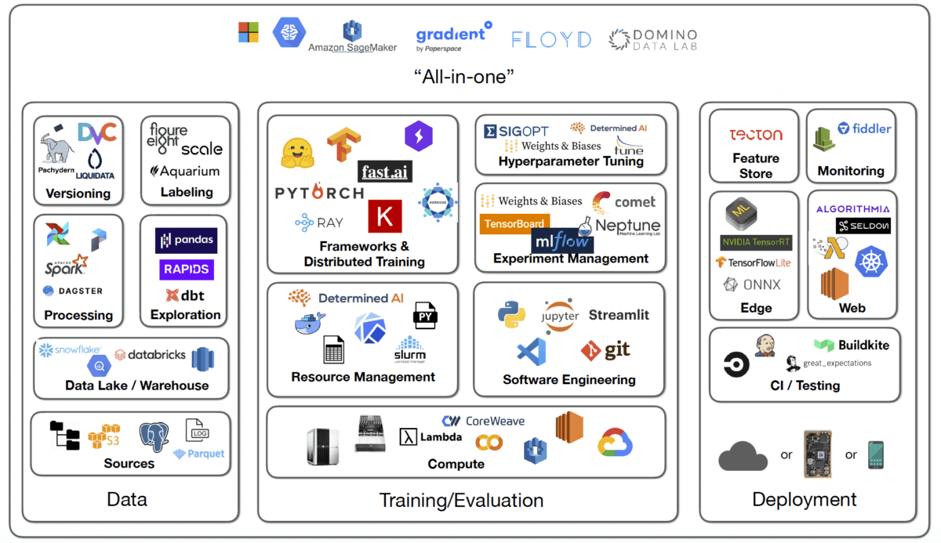
TOOLS FOR MLOPS
People :-
Process :-
Technology :-

Slide 16



COMPANIES USING MLOPS.
Uber :- To connect drive and deliver with riders, eaters, and restaurants, in a fast and efficient way.
Netflix :- To provide a an optimal and personalized movie streaming service for their users.
Doordash :- To be the last mile logistics layer in every city.

Slide 17

REFERENCE LINKS
https://mlflow.org/
https://ml-ops.org/
https://cloud.google.com/architecture/mlops-continuous-delivery-and-automation-pipelines-in-machine-learning
https://towardsdatascience.com/what-is-mlops-everything-you-must-know-to-get-started-523f2d0b8bd8
https://www.youtube.com/watch?v=ZVWg18AXXuE

Slide 18

CODE & REFERENCE LINKS

Slide 19
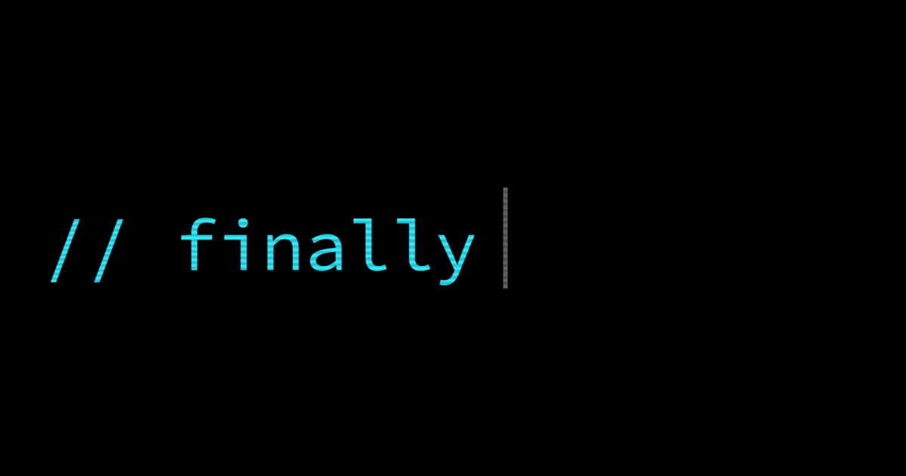
THANK YOU

